Slide 1
Presentation Title:
Predicting Customer Churn for SyriaTel
Using Machine Learning to Retain More Customers and Increase Revenue

Slide 2
Title Slide
Title : Predicting Customer Churn for SyriaTel
Subtitle: Data Science Project – Phase 3
Presented by : Lucy Muchiri
Date : 12/2/2026

Slide 3
Agenda / Overview
What we will cover today:
  >Business problem & why it matters
  >Our data and approach
  >Key findings from the model
  >Financial impact
  >Recommended actions

Slide 4
The Business Problem – Why Customers Leave
The Challenge:
  SyriaTel loses ~15% of its customers each year.
  That’s thousands of customers and millions in lost revenue.
  Reacting after a customer leaves is expensive (cost to acquire a new customer is 5× higher than retaining one).
Our Goal:
  Identify customers who are likely to churn before they leave.
  Enable proactive retention offers – the right offer, to the right person, at the right time.
Visual: A simple bar chart showing current churn rate vs. target reduction.

Slide 5
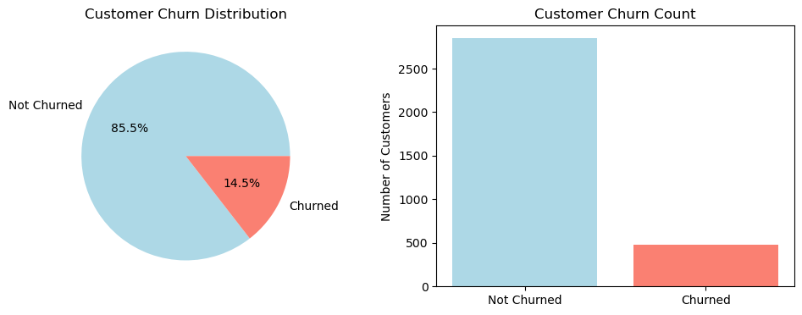
Customer Churn Distribution

Slide 6
Our Data- What we Analyzed
Data source: 3,333 customer records from SyriaTel’s system.
What we looked at:
  Account details (tenure, international plan, voicemail plan)
  Usage patterns (minutes & charges – day, evening, night, international)
  Customer service interactions (number of calls to support)
Key insight from data:
  Customers with international plans and frequent service calls are far more likely to churn.
  Visual: Side-by-side bar chart showing churn rate for “international plan = yes” vs “no”.

Slide 7
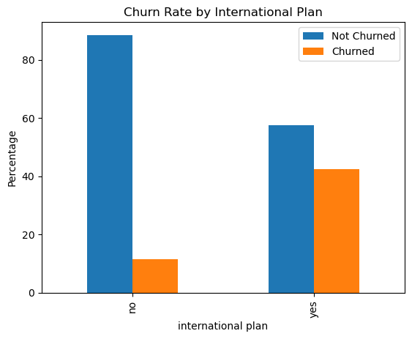
Churn by International Plan

Slide 8
Model Performance
Our primary metric: “Detection rate” (Recall)
  How many of the customers who actually churned did we correctly flag?
  Result: We identify 81% of churners before they leave.
Why this matters:
  Without the model: react after they leave → high cost.
  With the model: reach out while they are still customers → save revenue.
Visual: A bar chart showing “Churners identified” vs “Missed” (e.g., 81% vs 19%).

Slide 9
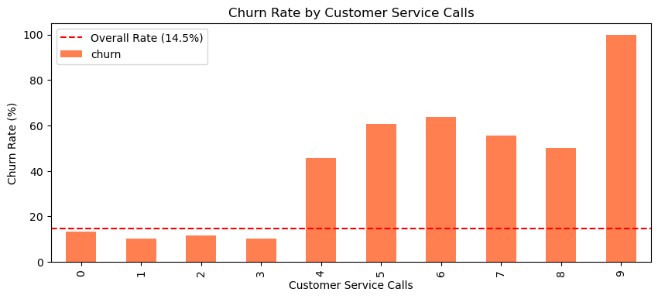
Churn Rate by Customer Service Calls

Slide 10
Financial Impact
Assumptions (based on industry averages):
  Average monthly revenue per customer: $50
  Retention offer success rate: 30%
  Cost of retention campaign: $20 per customer
Annual impact (projected):
  Revenue saved: $120,000
  Campaign cost: $40,000
  Net benefit: $80,000 per year
  ROI: 2× (for every $1 spent, SyriaTel gets $2 back)

Slide 11
Key Drivers
Top 3 factors (feature importance):
  Customer service calls – customers with 4+ calls are extremely high risk.
  International plan – these customers churn at nearly double the rate.
  Daytime charges – high usage correlates with higher churn.
What this tells us:
  Service problems are a major cause of churn.
  International plan may be overpriced or poorly valued.
  Our model gives us clear, actionable signals.

Slide 12
Recommendations
Immediate actions (next 30 days):
  Deploy the model – score all customers weekly and flag those with >70% churn probability.
  Prioritize high-risk segments:
    Customers with international plan + 3+ service calls
    Customers with 4+ service calls in the last month
  Offer targeted retention incentives – e.g., one-month discount, free upgrade.
Customer service improvements:
  Implement a callback system to reduce hold times.
  Train agents to identify and assist at-risk customers.

Slide 13
Next Steps
Monitor & refine:
  Retrain the model every 3 months with fresh data.
  A/B test different retention offers to find what works best.
Expand the data:
  Include customer feedback, competitor pricing, and web/app usage.
Build a retention dashboard:
  Give management real-time visibility into churn risk.

Slide 14
THE END
THANK YOU

